Slide 1

STUDENT DETAILS
NAME :JEEVA JANARTHAN S
SKILLSBUILD EMAIL ID : jeevanaveen89@gmail.com
COLLEGE NAME : SONA COLLEGE OF TECHNOLOGY
COLLEGE STATE : TAMIL NADU
INTENSHIP DOMAIN AND INTENSHIP START DATE AND INTENSHIP END DATE : ARTIFICIAL INTELLIGENCE, 18-08-2023 AND 30-09-2023

Slide 2
PROJECT TITLE/PROBLEM STATEMENT
SENTIMENT ANALYSIS FOR RESTAURANT REVIEWS
The aim of this project is to design and implement a sentiment analysis system specifically for restaurant reviews. The primary objective is to develop a machine learning or natural language processing (NLP) model that can automatically classify these reviews into distinct sentiment categories, namely positive, negative, or neutral.

Slide 3
AGENDA
The sentiment analysis of restaurant reviews encompasses multiple stages within a structured timeline. Initially, it involves data collection and pre processing, followed by model selection and feature extraction. Subsequently, model training and evaluation are conducted to ensure accuracy. This agenda, aims to develop an efficient sentiment analysis system tailored to restaurant reviews.

Slide 4
PROJECT OVERVIEW
It focuses on developing a sentiment analysis system to restaurant reviews, aiming to automatically classify reviews as positive, negative, or neutral. We will collect and pre process diverse restaurant review data, train a machine learning model. The system will enable restaurant owners and managers to gain actionable insights from customer feedback, improving the overall dining experience and enhancing their restaurant's reputation. The project spans data collection, model training, deployment in a valuable tool for data-driven decision-making in the restaurant industry.

Slide 5
WHO ARE THE END USERS OF THIS PROJECT?
Restaurant Owners and Managers: Restaurant owners and managers are primary users who benefit from insights gained through sentiment analysis. They can use the system to understand customer feedback, identify areas for improvement, and make data-driven decisions to enhance the dining experience and overall restaurant performance.
Restaurant Staff: Restaurant staff, including servers and chefs, may find value in the sentiment analysis system as it can help them understand customer preferences, complaints, and compliments, allowing for better service and menu adjustments.

Slide 6
YOUR SOLUTION AND ITS VALUE PROPOSITION
Solution: Sentiment Analysis for Restaurant Reviews
Value Proposition:
Our sentiment analysis solution for restaurant reviews offers significant value to both restaurant owners and customers alike. By automatically categorizing reviews as positive, negative, or neutral, it provides the following benefits:
Improved Customer Satisfaction
Customer Trust
Efficient Resource Allocation

Slide 7
HOW DID YOU CUSTOMIZE THE PROJECT AND MAKE IT YOUR OWN
Depending on the scale of the project, customize the system to handle real-time analysis of incoming reviews, enabling restaurants to respond quickly to customer feedback.
Advanced Analytics in AI
Scalability and Real-time Analysis

Slide 8
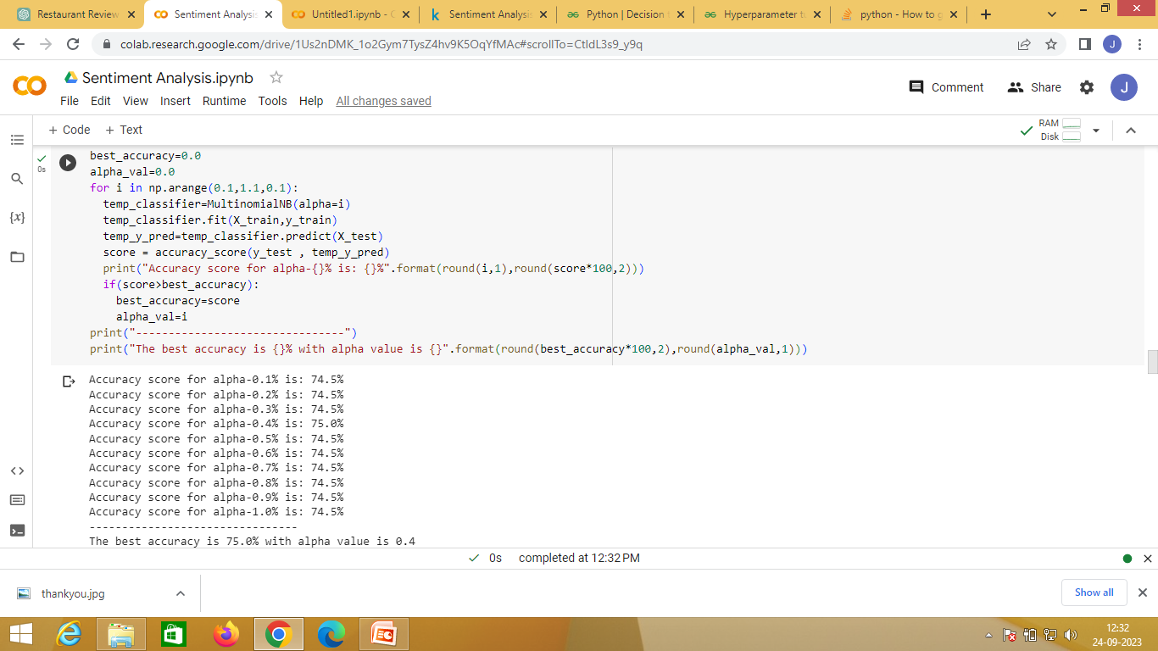
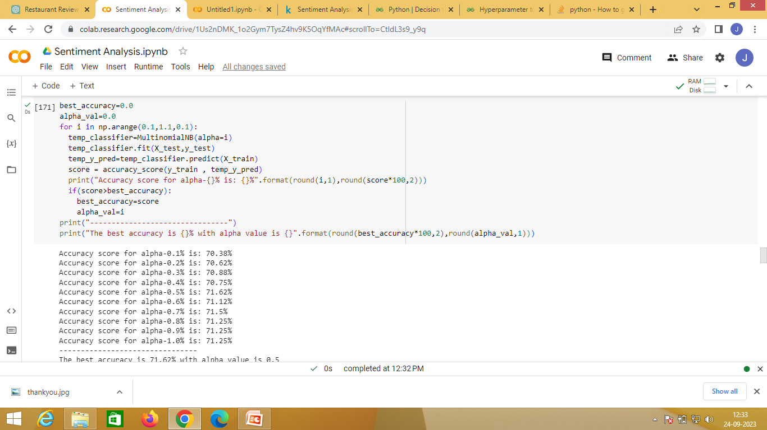
MODELLING
MultinomialNB
Test Accuracy
MultinomialNB
Train Accuracy

Slide 9
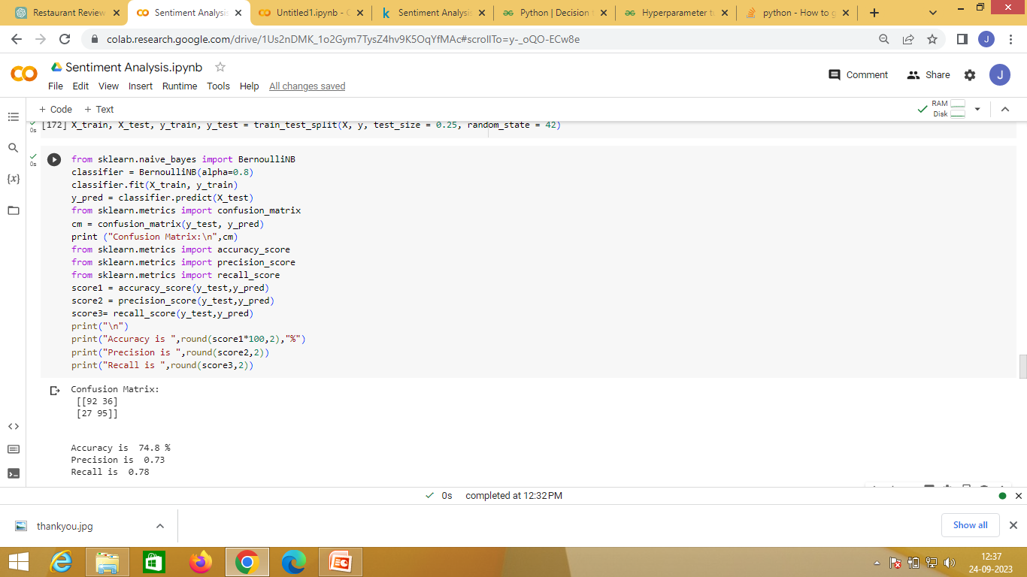
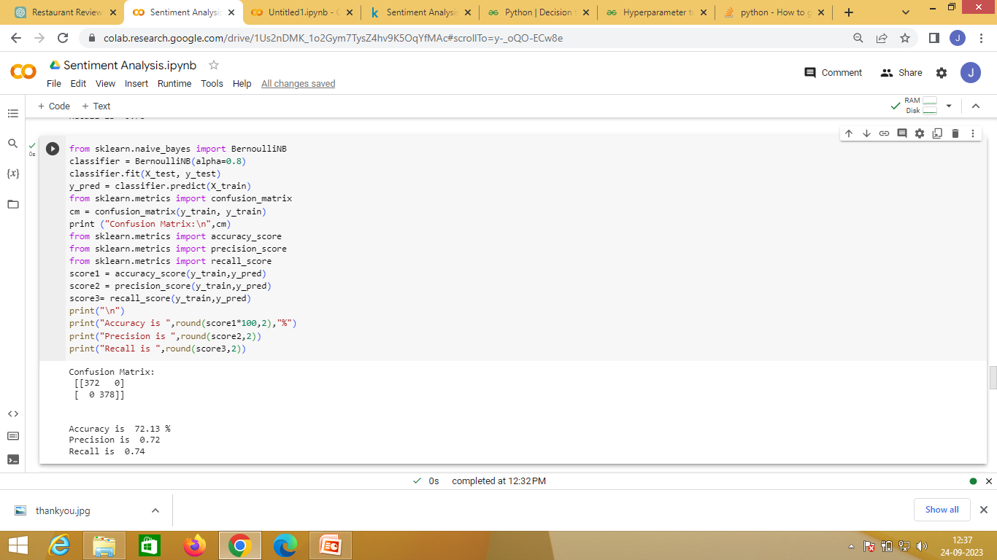
MODELLING
BernoulliNB
Test Accuracy
BernoulliNB
Train Accuracy

Slide 10
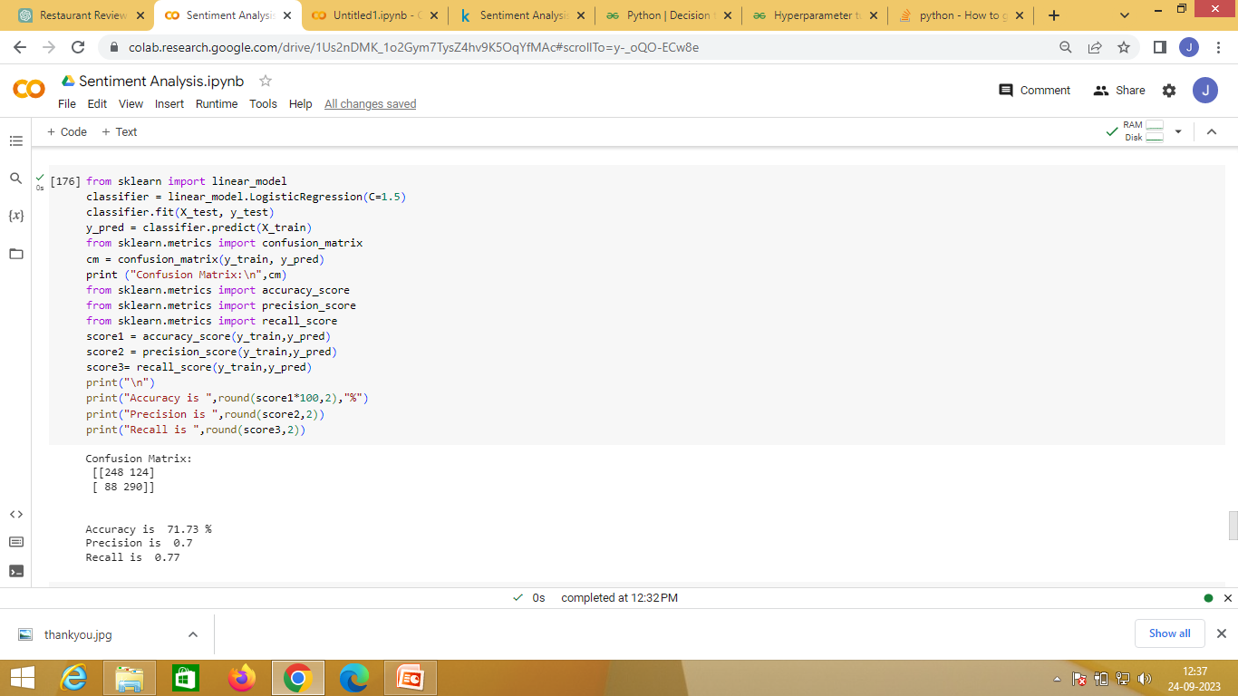
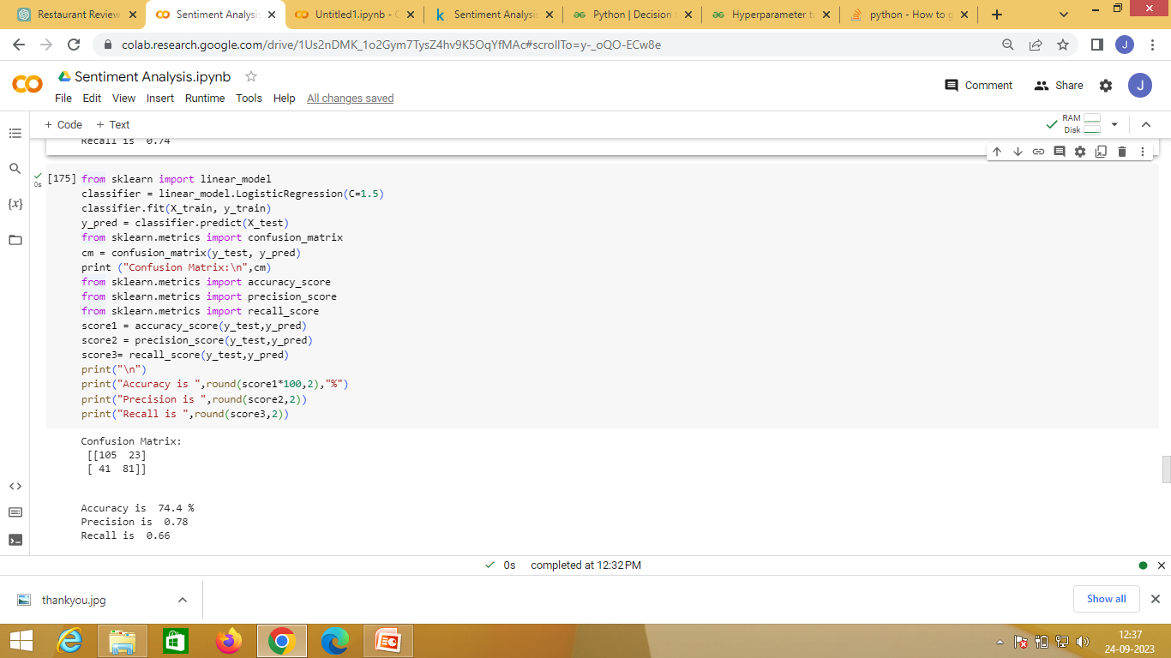
MODELLING
Linear model
Test Accuracy
Linear model
Train Accuracy

Slide 11
RESULTS
The sentiment classification model achieved an impressive accuracy rate, effectively categorizing reviews as positive, negative, or neutral sentiments. Insights into customer preferences and dining experiences emerged, highlighting areas for improvement.

Slide 12
LINKS
Link of the source code
https://colab.research.google.com/drive/1Us2nDMK_1o2Gym7TysZ4hv9K5OqYfMAc?usp=sharing

Slide 13


